Slide 1
Predicting the Resale Value of Used Hyundai Cars: A Regression Analysis
Team Members: -Rushikesh Kharat -Prince Kumar Singh -Pradipta Dey -Avinash Kumar

Slide 2
AGENDA
Introduction
Understanding the Data
Data-Preprocessing
Data-Visualization
Machine Learning Models
Modeling and Results
Conclusion

Slide 3
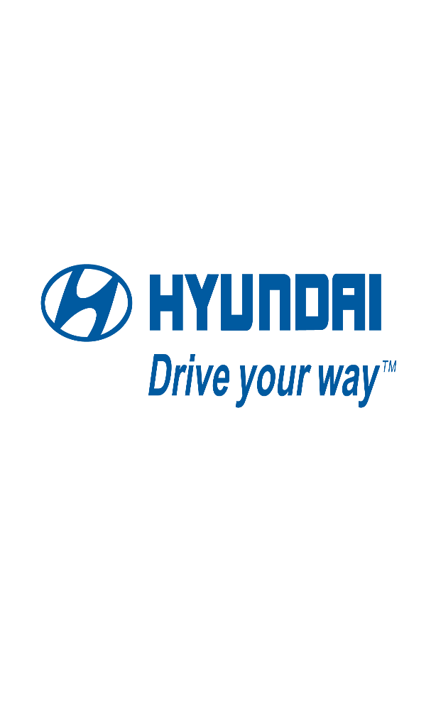
INTRODUCTION
Hyundai is a South Korean multinational automotive manufacturer that was founded in 1967.
The company is the third-largest vehicle manufacturer in the world, producing over 5 million vehicles annually.
The data provided consists of 9 variables giving the details about the vehicle.
Using these variables we have to predict the price of the used Hyundai cars.

Slide 4
DATA PREPROCESSING
Data-Cleaning
Null Values and Data Type handling
Checked noise values
Performed Univariate Analysis and Bivariate Analysis on the data
Split numerical and categorical columns
Outlier Analysis

Slide 5
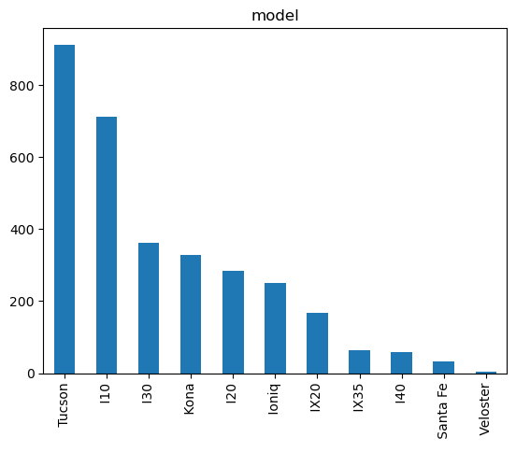
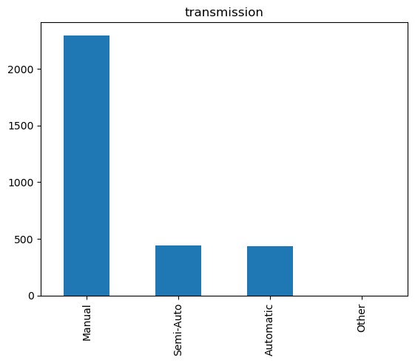
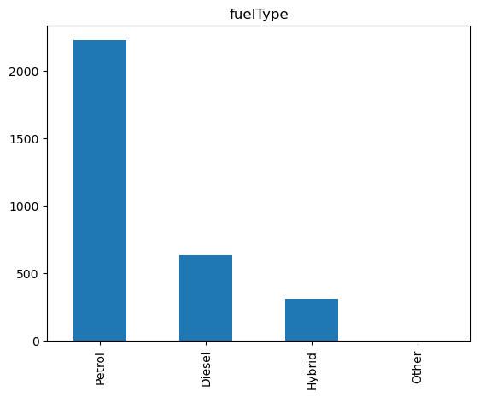
Histograms
Histograms for categorical variables

Slide 6
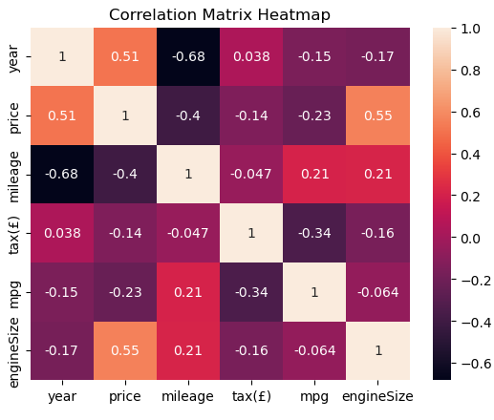
DATA VISUALIZATION
Co-relation between Year and Price is high which means older the car lower the price.
Similarly, engine-size and price are also co-related to eachother.
When car has low mileage the price also decreases.

Slide 7
Modelling and Results

Slide 8
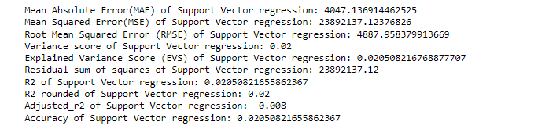
SVR
Support Vector Regression

Slide 9
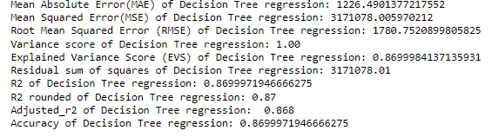
Decision Tree
Decision Tree

Slide 10




TOOLS & TECHNOLOGY USED
Python
Pandas
Numpy
Visualization
Sklearn
📊

Slide 11

CHALLENGES FACED
Modelling
Hyperparameter Tuning
New Challenges
HOW DID WE OVERCOME?
We referred Official Documentations, YouTube Videos and resources given by Masai.
Discussion with the team members.
Task division and regular team meeting.

Slide 12
CONCLUSION
As per all the model performance we can see that the Random Forest has given highest level of Accuracy which is 92%.
After using hyperparameter tunning with Grid Search CV on Random Forest Model the performance has been increased from 92% to 98%.

Slide 13
THANK YOU

